Slide 1
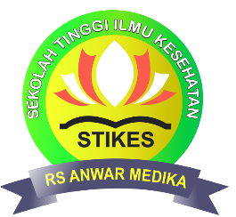
Effect of using Laja Gowah (Alpinia malaccensis (Brum.f) Roscoe) oil in Reducing the Number of Staphylococcus aureus Colonies in Hospital Inpatient Rooms
International Conference of the Indonesian Chemical Society
11 – 13 Agustus 2021
Khoirun Nisyak, S.Si., M.Si.
STIKES Rumah Sakit Anwar Medika

Slide 2
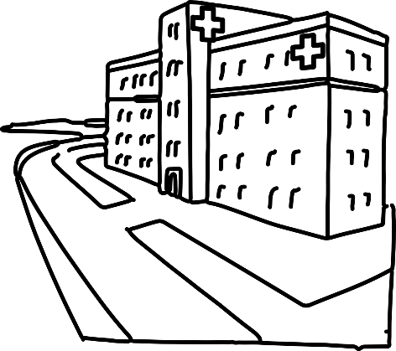
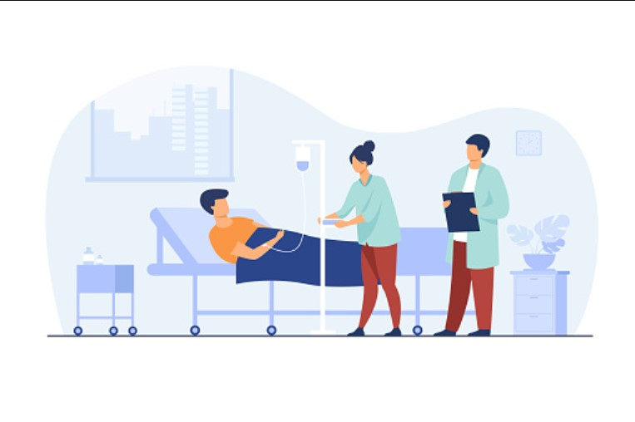
Introduction
NOSOCOMIAL INFECTION
healthcare-associated infections (HAI), are infection(s) acquired during the process of receiving health care that was not present during the time of admission
The causes of NI =>
the use of medical equipment,
treatment items,
aids for defecation and urination,
air circulation
HOSPITAL
Notes:
The hospital is a community health service center providing comprehensive services, healing disease (curative), and disease prevention (preventive). The treatment room is a space for patients who need continuous care and nursing services and treatment for more than 24 hours (Kemenkes, 2016). The hospital environment has a major influence on the patient's healing process. Unclean environmental conditions can be an excellent place for the breeding of disease vectors and can be a factor in the occurrence of nosocomial infections (Hidayati et al., 2017).
Nosocomial infection is an infection that develops in a hospital environment (Guo & Li, 2019). Nosocomial infections are one of the biggest causes of death in patients undergoing hospital treatment, especially in class III inpatient rooms which have a crowded home environment, the activity of moving patients from one unit to another is mostly done in that place. The percentage of nosocomial infections in the world's hospitals reaches 9% or more 1.4 million hospitalized patients worldwide. Research conducted by WHO showed that about 8.7% of 55 hospitals from 14 countries originating from Europe, the Middle East, Southeast Asia and the Pacific showed nosocomial infections and for Southeast Asia as much as 10.0%. The causes of nosocomial infections include the use of medical equipment, treatment items, aids for defecation and urination, as well as through air circulation

Slide 3
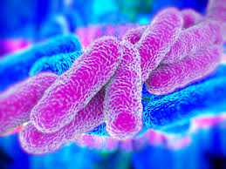
Gram-positive bacteria that are pathogenic and form biofilms, one of the causes of nosocomial infections in hospital inpatient rooms
infection due to pathogenic bacteria, the spread is through air media (airbone)
Staphylococcus aureus
ANTIBACTERIAL AGENT
Handling to suppress the spread of pathogenic bacteria in hospital inpatient rooms ➔ carbolic fluid and spraying a disinfectant with an active ingredient of sodium hypochlorite
Notes:
One of the causes of nosocomial infections in hospital inpatient rooms is Staphylococcus aureus bacteria (Horváth et al., 2016). Some infections caused by the pathogenic bacterium S. aureus are associated with mortality rates comparable to those caused by HIV/AIDS, tuberculosis and viral hepatitis. (Coté et al., 2016). Bazargani & Rohloff (2016) reported the incidence of infection caused by Methicillin Resistant Staphylococcus aureus (MRSA) is relatively high, there are about 14 million health cases for the skin.
In most cases of infection due to pathogenic bacteria, the spread is through air media (airbone). The use of antibacterial materials needs to be done to suppress the spread of pathogenic bacteria in the air in hospital inpatient rooms. Handling to suppress the spread of pathogenic bacteria in hospital inpatient rooms have been carried out by cleaning the floor with carbolic fluid and spraying a disinfectant with an active ingredient of sodium hypochlorite. Most floor cleaners and disinfectants contain chlorine which is corrosive and has a long term adverse effect on the respiratory tract (Clausen et al., 2020).

Slide 4
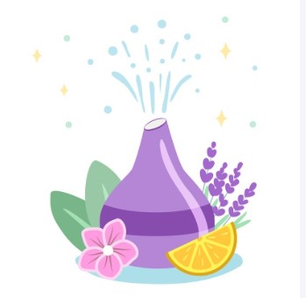
air diffusion method by utilizing a humidifier equipped with an ultrasonic diffuser.
Humidifier is a device that functions as an air humidifier that can increase humidity by spraying water vapor into the air.
Water vapor that is sprayed can bind to bacteria and viruses in the air.
A humidifier equipped with an ultrasonic diffuser is able to break down essential oil molecules into small particles due to the effect of ultrasonic vibrations which are then diffused through water vapor
Essential Oil Diffuser

Slide 5
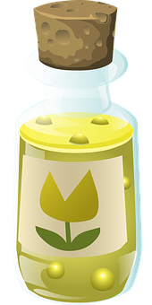
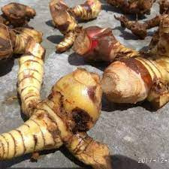
Laja gowah (Alpinia malaccensis (Brum.f) Roscoe)
The main content of laja gowah essential oil is methyl cinnamate, cineol -pinene
LGO is reported to have antibacterial activity against Gram negative and Gram positive bacteria (Sitorus & Satria, 2016).
Methyl cinnamate is a derivative of cinnamic acid which is widely used in the cosmetic industry
the antibacterial activity of laja gowah oil was tested against the spread of S. aureus bacteria in the hospital inpatient room using the air diffusion method.
Notes:
Laja gowah or forest galangal (Alpinia malaccensis (Burm.f.) Roscoe) is a plant from the Zingiberaceae family that is related to white galangal and red galangal. Laja gowah has been used as a medicinal plant by the people of Indonesia. The rhizome of laja gowah is used as a medicine for ulcers, wound medicine, stomachache medicine, and strong medicine. Laja gowah fruit can be eaten and used as a cooking spice or dried as tea. Laja gowah oil was isolated from the rhizome of the laja gowah plant by means of the steam distillation method. Laja gowah oil is one of Indonesia's newly developed essential oil commodities with promising business prospects.
The essential oil used in the study was laja gowah (Alpinia malaccensis (Brum.f) Roscoe) oil. The main content of laja gowah essential oil is methyl cinnamate 80.86%, cineol 8.75%, -pinene 3.68% and the remaining -pinene, -terpineol (Riyanto, Yunilawati, & Nuraeni, 2012). Laja gowah oil is reported to have antibacterial activity against Gram negative and Gram positive bacteria (Sitorus & Satria, 2016). The antibacterial activity of laja gowah is associated with the content of methyl cinnamate compounds. Methyl cinnamate is an ester group compound of cinnamic acid with the formula C₁₀H₁₀O₂ which has a benzene ring and there is a double bond in its structure. (Ernawati, Budiana, & Ernawati, 2016). Methyl cinnamate is a derivative of cinnamic acid which is widely used in the cosmetic industry (Padalia et al., 2017). In this study, the antibacterial activity of laja gowah oil was tested against the spread of S. aureus bacteria in the hospital inpatient room using the air diffusion method.

Slide 6
Materials and Method
The research was conducted in the third class inpatient room at Rumah Sakit Umum Anwar Medika Sidoarjo, Microbiology Laboratory in STIKES Rumah Sakit Anwar Medika and Instrumentation Laboratory of Brawijaya University Malang in May – August 2019.
The materials used include laja gowah oil (Galanga Oil, CV. Nusaroma). Depok), Mannitol Salt Agar (Merck), aquades, Lugol's reagent, safranin, and Crystal violet. The instruments used include Gas Chromatography-Mass Spectrophotometer (GCMS QP 2010, Shimadzu), autoclave (GEA), incubator (Memmert), and Essential Oil Diffuser.

Slide 7
Method
Characterization of laja gowah oil
Identification S. aureus in hospital ward
Antibacterial test of laja gowah oil
Data Analysis
GC-MS
Air capture method
Gram staining
Catalase test
Coagulase test
Diffuser EO
Notes:
Laja Gowah Oil Characterization
Laja gowah oil was analyzed for its chemical compound content using GC-MS to obtain information on the content of chemical compounds and their composition through the chromatogram pattern and mass spectrum of each peak. The column used for essential oil analysis by GC-MS is the Rtx-5MS column (5% diphenyl – 95% dimethyl polysiloxane) which has low polarity with N2 carrier gas.
Identification of S. aureus in third class patient wards
Initial identification of S. aureus bacteria in class III inpatient rooms was carried out by the air capture method. A petri dish containing 15 mL of Mannitol Salt Agar (MSA) media used as a selective medium for S. aureus was placed in the corner of the class III inpatient room (5 m x 7 m, room area 35 m2) with an open condition for 1 hour. The Petri dishes were then closed and incubated in an incubator for 24 hours at 37°C. In the next step, a quantitative test was carried out by counting the colonies using the Colony Counter. Colonies were taken for qualitative test using Gram staining method by adding crystal violet and allowed to stand for 2 minutes, then rinsed with running water. The next step is added Lugol's solution, allowed to stand for 1 minute, and rinsed with running water. Then the preparation is rinsed with alcohol for 10-20 seconds and rinsed with running water. The last step was the addition of safranin and left for 1 minute then rinsed with running water. The slide is ready to be identified with a low magnification microscope. The magnification was carried out gradually until a purple cocci form was obtained which indicated Gram-positive bacteria.
The next identification is the catalase test is carried out by taking a few colonies from MSA media and placing the colonies on a slide that has been dripped with H₂O₂. The presence of air bubbles in the bacterial colony isolates indicates that the bacterial colonies include Staphylococcus sp., if no air bubbles appear, it indicates the Steptococcus sp. The last identification was a coagulase test with plasma citrate, where the object glass was given one drop of plasma citrate and sodium citrate and 0.9% sodium citrate, then took the colonies that grew on MSA media with ose and homogenized. The presence of lumps on the slide shows that the isolate of the bacterial colony is S. aureus. The results of the quantitative and qualitative tests were used to ensure that the isolates of bacterial colonies obtained from air catches in the inpatient room were S. aureus bacteria.
Laja Gowah Oil Antibacterial Activity Test
A total of 1 mL of laja gowah oil which was used as a test material was inserted into the essential oil diffuser set which already contained 400 mL of distilled water and was connected to a power source. Every 6 hours, distilled water was replaced and essential oil was added. The diffuser that is ready to be placed in the corner of the inpatient room is on. Microbial sampling was carried out at the 6th, 12th, 24th, 36th, and 48th hours. The method of analyzing the S. aureus bacteria present in the room was carried out by the air capture method using the same procedure as the initial identification of microbes in the inpatient room. Petri dishes that already contain MSA media are placed in every corner of the room and the center of the room, the position of the essential oil diffuser is placed on top of the patient's cupboard which is located in the corner of the room.
Data Analysis
The data obtained from the study include GC-MS chromatogram data and identification data of S. aureus bacteria. In the GC-MS chromatogram data, it can be seen the chemical compound content and levels in laja gowah oil by matching the fragmentation pattern, where the fragmentation pattern of the compound with a Similarity Index (SI) value> 90, is suspected to be the chromatogram of the volatile oil content compound. The identification data of S. aureus bacteria with the effect of the time of installation of a diffuser containing laja gowah oil on the number of S. aureus colonies were analyzed statistically using SPSS 21 software with linear regression test.

Slide 8
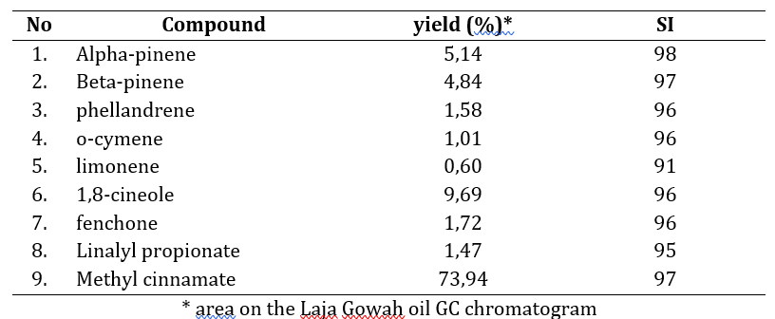
Result & Discussion
Chemical Compounds of Laja Gowah Oil

Slide 9
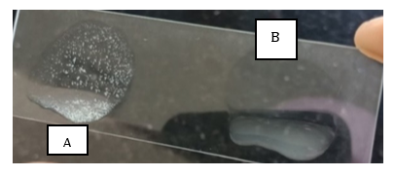
Identification of S. aureus Bacteria in Class Inpatient Rooms
Positive catalase test results for bacterial isolates (the presence of oxygen gas bubbles in both spheres)
Coagulase test results (A) are positive and (B) are negative
Gram stain of bacterial isolates from the inpatient room (10x100 magnification)
S. aureus

