Slide 1



Synthesis of Acetamide Compounds from α- Pinene through Sonochemical Ritter Reaction
with Ni/Natural Zeolite Catalyst
Khoirun Nisyak*, A’yunil Hisbiyah, and Desi Phingkarsa
Dept. of Pharmacy, Universitas Anwar Medika, Sidoarjo, Indonesia
Malang, 14 Oktober 2022
International Conference on Organic and Applied Chemistry Universitas Brawijaya

Slide 2

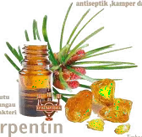

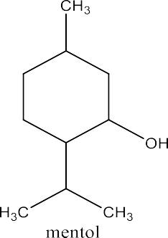
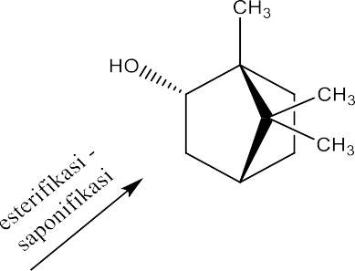


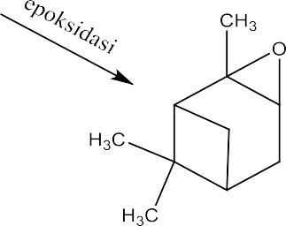




INTRODUCTION
Terpentine oil
alpha pinene was modified into organonitrogen compounds through the Ritter reaction.

Slide 4



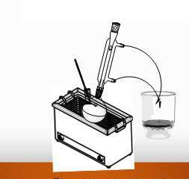
Ritter Reaction
ACID CATALYST
Ni/N-Zeolite
natural zeolite based heterogeneous catalyst with the addition of Ni
the addition of Ni metal can increase the acidity value which can increase its catalytic activity
The use of ultrasonic waves in the synthesis of chemical compounds encourages physical and chemical changes in liquid media and causes acoustic cavitation

Slide 5
OBJECTIVE
The purpose of this study ➔
to determine the reaction products obtained from the synthesis of acetamide compounds from -pinene through the Ritter reaction sonochemically using Ni/Natural Zeolite catalysts
To determine the effect of the type of catalyst for the synthesis of acetamide compounds from -pinene through the sonochemical Ritter reaction

Slide 6



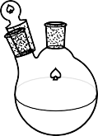







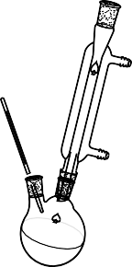
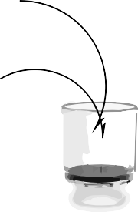
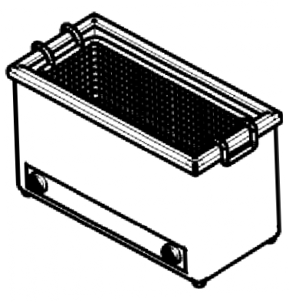




METHODS
Activation of Natural Zeolite
Impregnation of Ni to Zeolite
Characterization of catalyst
Synthesis Acetamide Compound
Separation of product
Characterization of product

Slide 7
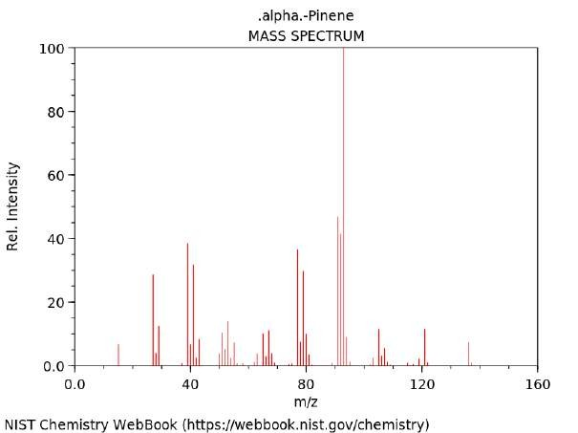
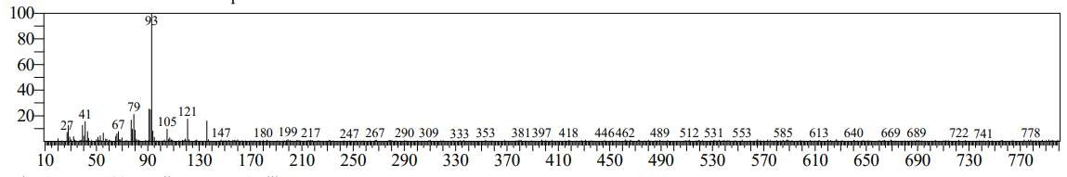
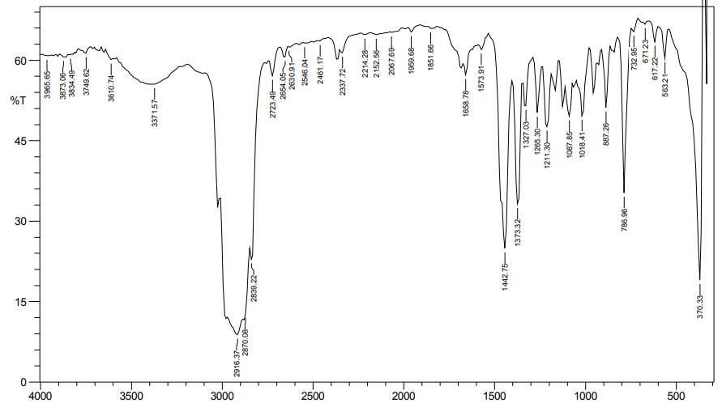
RESULT AND DISCUSSION
Alpha pinene as starting material
The levels of alpha- pinene in turpentine oil used as starting material is 93%

Slide 8
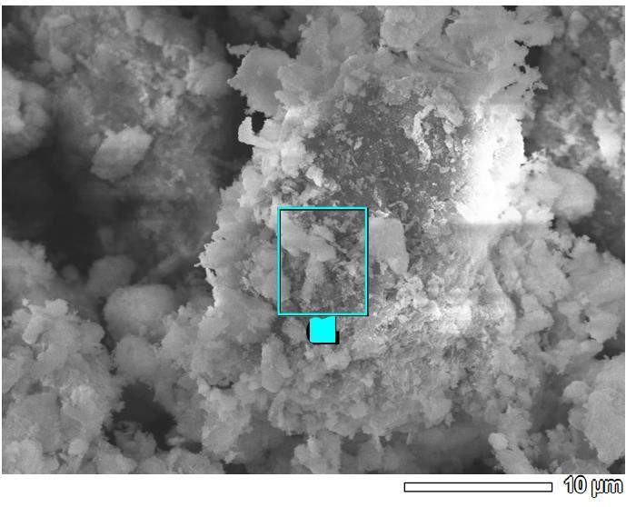
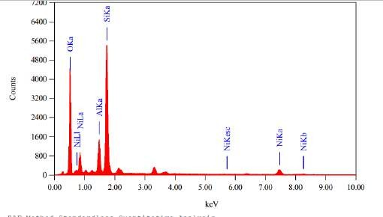
Charazterization of Ni/N-Zeolite Catalyst
Counts
B
 | 2θ
 | Standar | Ni/ZAA | 400
 |  | 35,6798
Ni JCPDS No. 65- 0380 | 35,840 37,80 50,146 | 37,2188 42,2240 | 200
 |  | 62,7864
0
20
30
40 50
Position [°2Theta] (Copper (Cu))
60
70
Elemen | Weight (%)
O | 52,03
Al | 6,87
Si | 27,45
Ni | 13,65
Total | 100,0

Slide 9
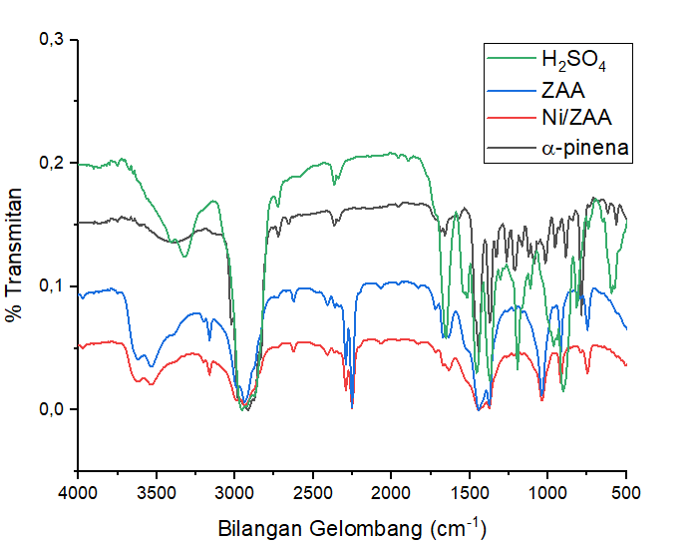
Charazterization of Reaction Product with FT-IR

Slide 10
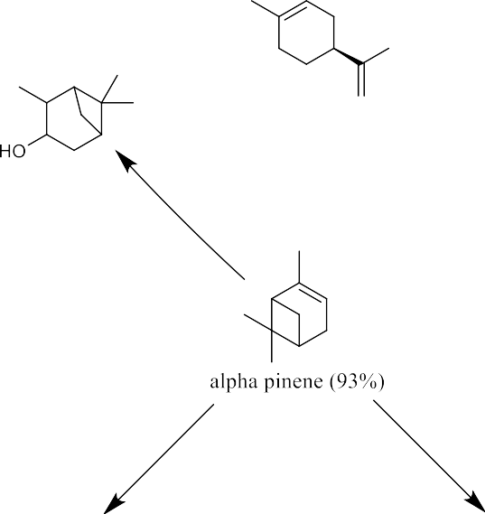

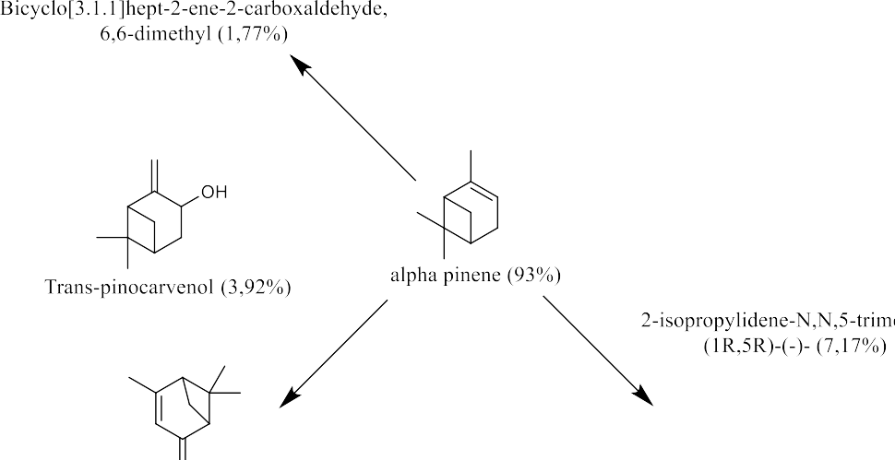

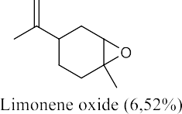


Charazterization of Reaction Product with GC-MS
Reaction with sulfuric acid by ultrasonication at room temperature for 5 h
Reaction with natural zeolite catalyst by ultrasonication at room temperature for 5 h

Slide 11

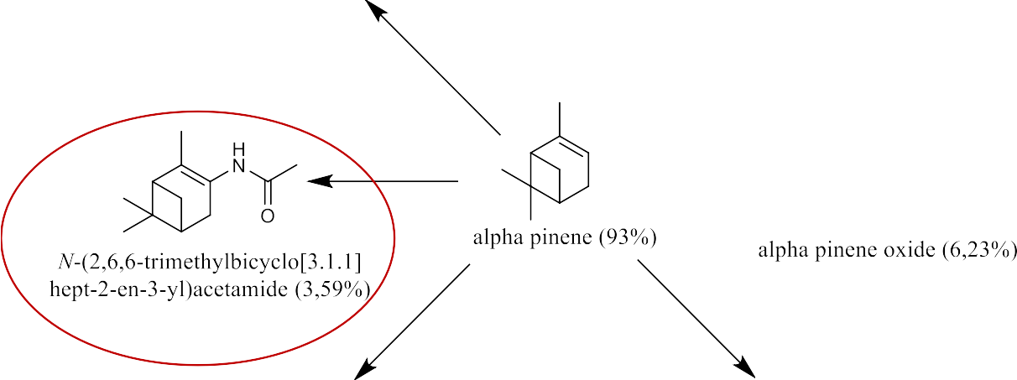

Reaction with Ni/ZAA catalyst by ultrasonication at room temperature for 5 h
Conversion of alpha pinene = 54,56%
% yield of product = 4.1%

Slide 12
CONCLUSION
Amide compounds are only formed in reaction products with a Ni/ZAA catalyst. Based on this, it can be concluded that the acidity of the catalyst affects the reaction products formed in the Ritter reaction. In addition, there is an effect of reaction time, in further research it is necessary to vary the reaction time using a Ni/Natural Zeolite catalyst

Slide 13

THANK YOU

