Slide 1
Antinephrolithiasis Activity of Ethanolic Extract of Uncaria gambir Roxb leaves
HMNP-4 ICPAPS – ISCC 2021
Khoirun Nisyak, Hardiansyah, and A’yunil Hisbiyah
STIKES Rumah Sakit Anwar Medika
2 – 4 November 2021
7th International Conference on Pharmacy and Advanced Pharmaceutical Sciences (ICPAPS 2021) &
12th Annual Conference of the Indonesian Society for Cancer Chemoprevention (ISCC 2021)

Slide 2
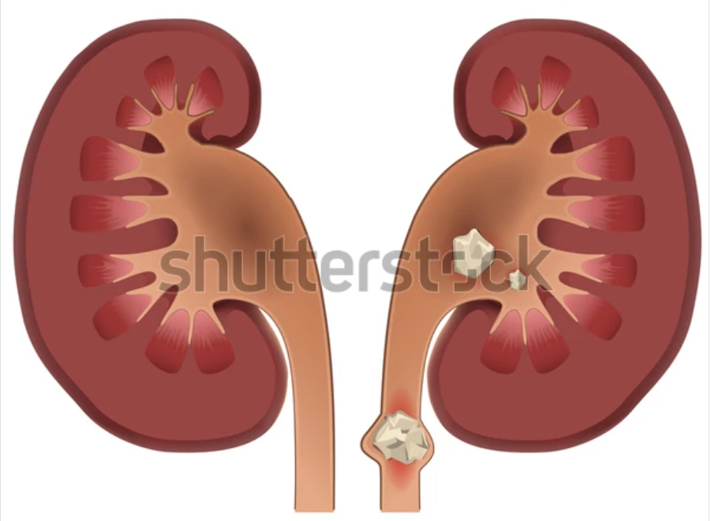
BACKGROUND
Nephrolithiasis = Kidney Stones
2013
0,6% Indonesia
0,7% Jawa timur 0,7% Sidoarjo
Ca-oxalate &
Ca-phosphate
renal calculi = crystal concretions formed typically in the kidney
SURGICAL INTERVENTION
high costs and results in risks, such as tissue damage, and bacteriuria infection

Slide 3
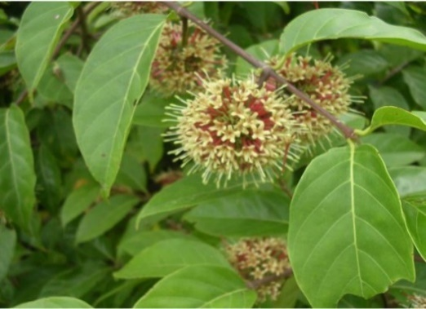
GAMBIR
Uncaria gambir Roxb.
antioxidant, antidiabetic, antimicrobial, anticancer, and anticariogenic
catechins, polyphenols, alkaloids, saponins, tannins, epicatechins, and caffeic acid
73%
prevent renal calcium crystallization in vivo and in vitro
Ca-Catechin Complex
Soluble in water

Slide 4
OBJECTIVE
The purpose of this study was to determine the effect and activity of ethanol extract of gambier leaves on the destruction of kidney stones in vitro.

Slide 5
METHODS
Extraction
Identification of chemical compounds
Characterization of Kidney stones
Kidney stones dissolution test
Data Analysis
Maceration with EtOH, fractionation with EA and n-hexane
Phytochemical screening with TLC and LC-MS
Qualitative test & XRF
Incubation at 37 C for 5 h, Ca level dissolved = AAS

Slide 6
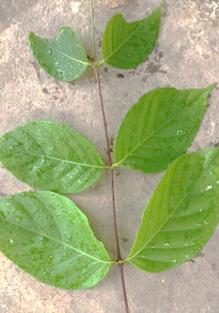
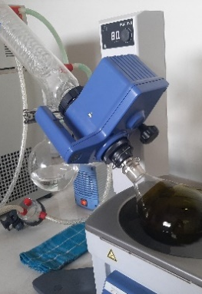
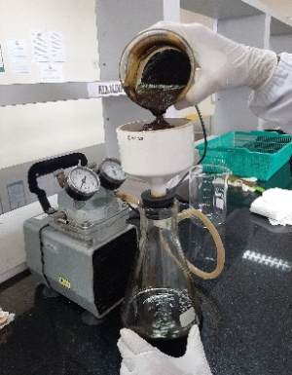
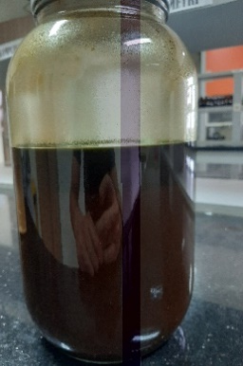
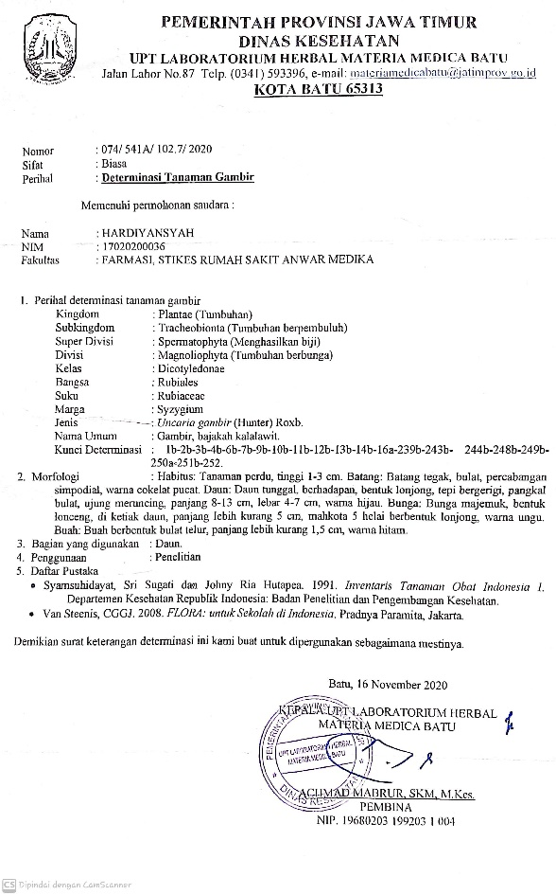
RESULT AND DISCUSSION
13,57%
Crude Ethanolic Extract
EA
Residue
N-hexane

Slide 7
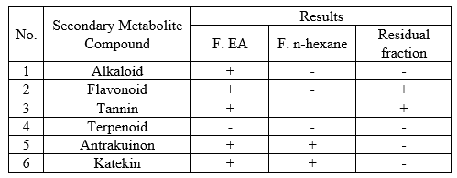
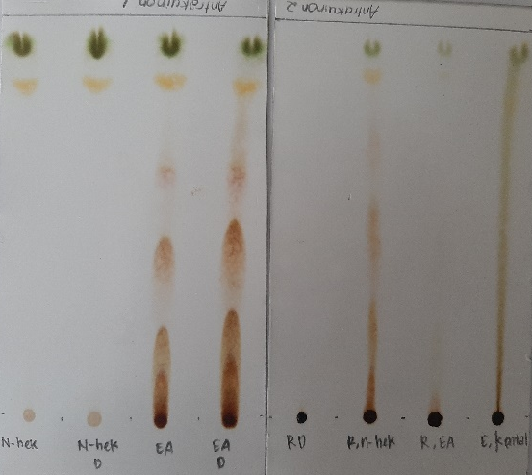
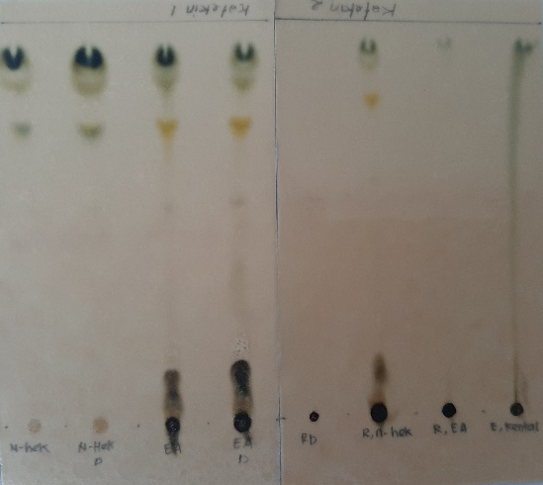
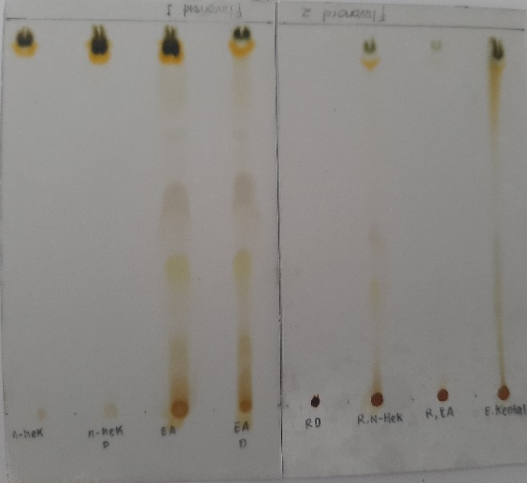
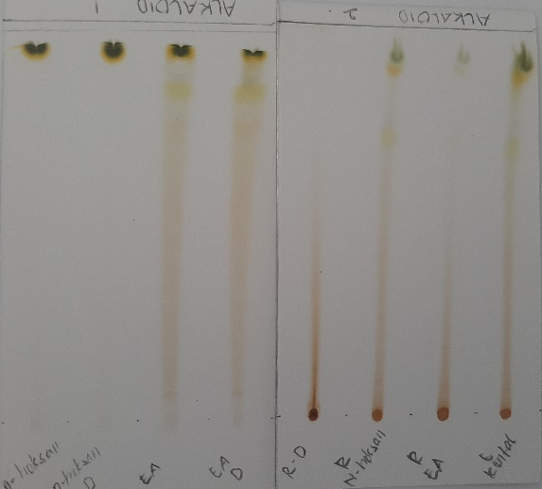
Phytochemical Screening of Gambir Leaves Extract

Slide 8
F. n-hexane
F. Ethyl acetate
Stigmastan-3,6-dione 5.67%, C₄₅H₈₄O₁₄ (m/z 871) 20.04%, C₄₅H₈₄O₁₅ (m/z 887) 5.98%, C₃₆H₄₄O₉ (m/z 621) 3,95%, C₂₈H₄₆O₂ (m/z 415) 3.3%
d-catechin 3,14%, Procyanidin A2 12,23%, C₂₃H₄₀O₁₉ (m/z 621) 17,89%, C₄₅H₈₄O₁₄ (m/z 871) 14,09%, C₂₃H₄₆O₂₀ (m/z 643) 5,87%
Residual Fraction
Grosvenorine 0.33%, Procyanidin A2 2%, Quercetin 0,41%, C₂₃H₄₀O₁₉ (m/z 621) 3,12%, C₂₃H₄₆O₂₀ (m/z 643) 2,24%

Slide 9
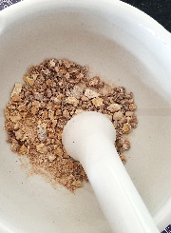
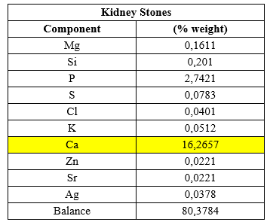
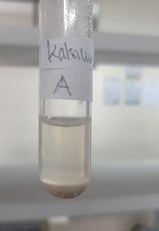
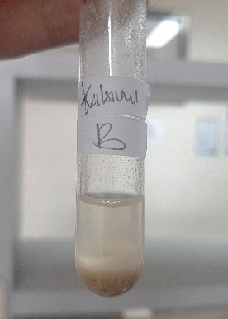
Characterization of Kidney Stones

Slide 10
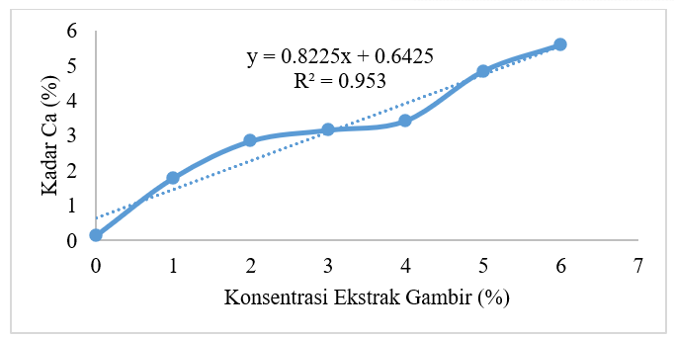
Kidney stone solubility test with ethanol extract of gambir leaves
The higher the concentration of gambir leaf extract, the higher the dissolved calcium level of kidney stones

Slide 11
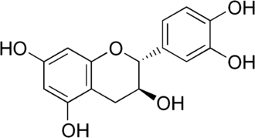
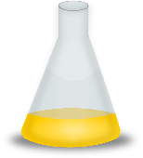
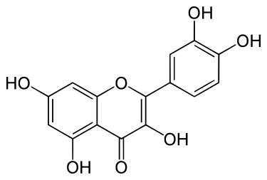
Plausible Mechanism of Reaction
catechins
quercetin

Slide 12
Data Analysis
F value > F table => the concentration of gambier leaf extract (X) has an influence on dissolved calcium levels (Y).

Slide 13
Conclusion
There is an effect of ethanol extract of gambir leaf as antinephrolithiasis agent, the higher the concentration of ethanol extract gambier leaves, the higher the calcium levels of dissolved kidney stones.
The presence of catechin compounds in gambier leaves can react with calcium in kidney stones to form a water-soluble Ca-catechin complex.

Slide 14
THANK YOU

