Slide 1
Study on Antinephrolithiasis Activity of Ethanolic Extract of Uncaria gambir Roxb leaves
Khoirun Nisyak^{1*}, A’yunil Hisbiyah¹, Hardiansyah¹, and Rahadian Zainul²
¹ Department of Pharmacy, Faculty of Health Science, Universitas Anwar Medika, Indonesia
² Department of Chemistry, Faculty of Mathematics and Natural Science, Universitas Negeri Padang, Indonesia
12 – 13 Oktober 2022 International Seminar on Chemistry (ISOC V) – Institut Teknologi Sepuluh

Slide 2
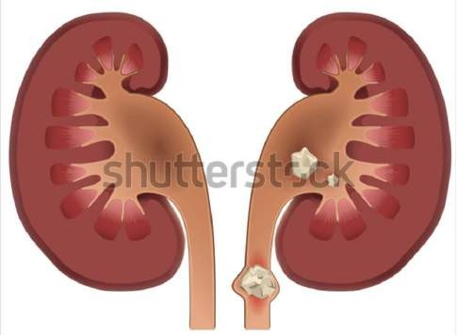
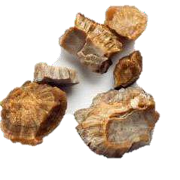
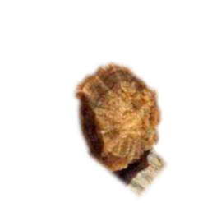
BACKGROUND
Nephrolithiasis = Kidney Stones
2013
0,6% Indonesia
0,7% Jawa timur
0,7% Sidoarjo
Ca-oxalate & Ca-phosphate
renal calculi = crystal concretions formed typically in the kidney
SURGICAL
INTERVENTION
high costs and results in risks, such as tissue damage, and bacteriuria infection

Slide 3
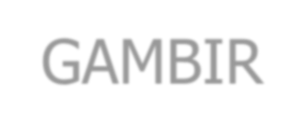
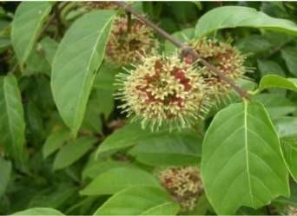
GAMBIR
Uncaria gambir Roxb.
antioxidant, antidiabetic, antimicrobial, anticancer, and anticariogenic
catechins, polyphenols, alkaloids, saponins, tannins, epicatechins, and caffeic acid
prevent renal calcium crystallization in vivo and in vitro
73%
Soluble in
water
Ca-Catechin Complex

Slide 4
OBJECTIVE
The purpose of this study was to determine the effect and activity of ethanol extract of gambier leaves on the destruction of kidney stones in vitro.

Slide 5
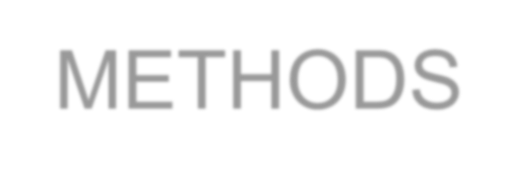
METHODS
Extraction
Maceration with EtOH, fractionation with EA and n-hexane
Identificatio n of chemical compounds
Phytochemical screening with TLC and LC-MS
Characterization
of Kidney stones
Qualitative test & XRF
Incubation at 37 C for 5 h, Ca level dissolved = AAS
Kidney stones dissolution test
Data
Analysis

Slide 6
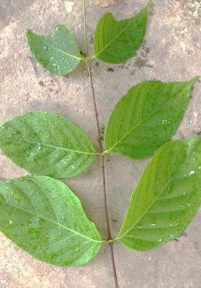
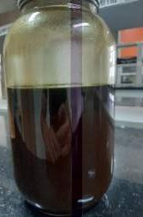
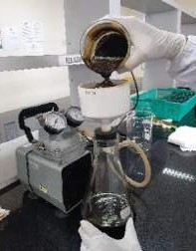
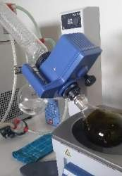
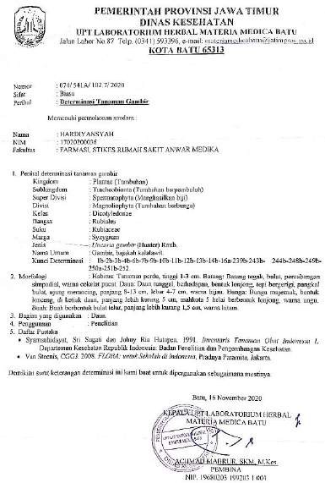
RESULT AND DISCUSSION
13,57%
Crude Ethanolic
Extract
EA
Residue
N-hexane

Slide 7
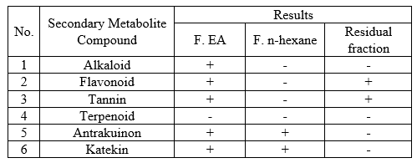
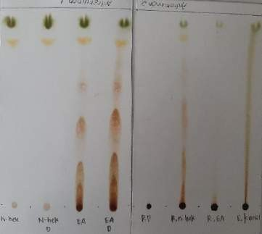
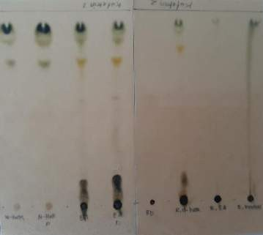
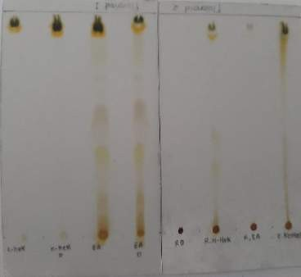
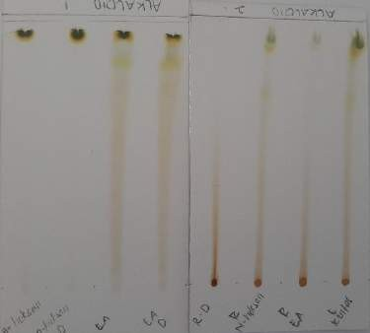
Phytochemical Screening of Gambir Leaves Extract

Slide 8
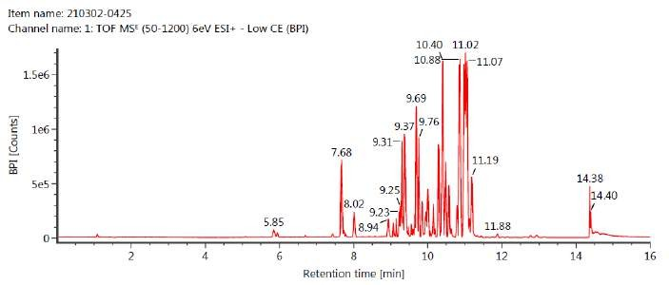
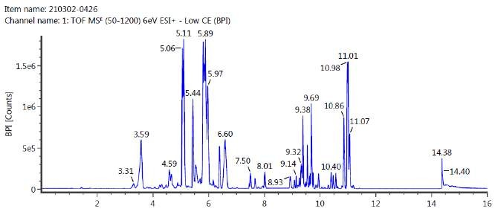
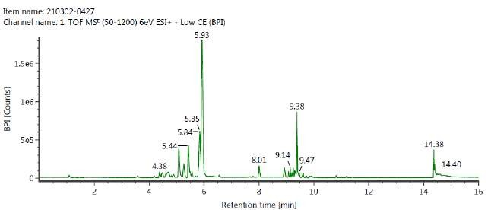
F. Ethyl acetate
F. n-hexane
Stigmastan-3,6-dione 5.67%, C₄₅H₈₄O₁₄ (m/z 871)
20.04%, C₄₅H₈₄O₁₅ (m/z 887) 5.98%, C₃₆H₄₄O₉ (m/z
621) 3,95%, C₂₈H₄₆O₂ (m/z 415) 3.3%
d-catechin 3,14%, Procyanidin A2 12,23%,
C₂₃H₄₀O₁₉ (m/z 621) 17,89%, C₄₅H₈₄O₁₄ (m/z 871)
14,09%, C₂₃H₄₆O₂₀ (m/z 643) 5,87%
Residual Fraction
Grosvenorine 0.33%, Procyanidin A2 2%,
Quercetin 0,41%, C₂₃H₄₀O₁₉ (m/z 621) 3,12%,
C₂₃H₄₆O₂₀ (m/z 643) 2,24%

Slide 9
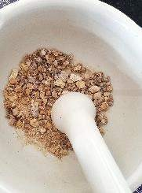
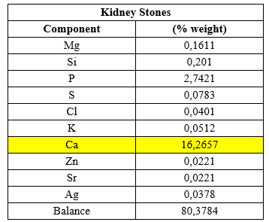
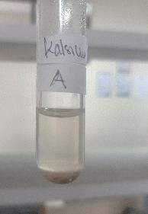
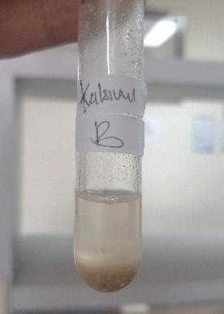
Characterization of Kidney Stones

Slide 10
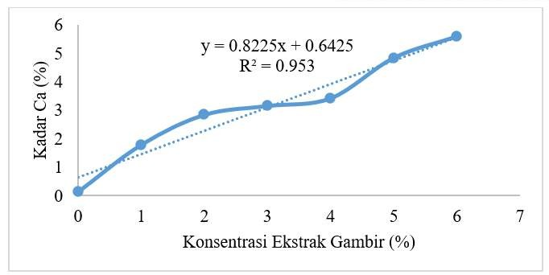
Kidney stone solubility test with ethanol extract of gambir
leaves
The higher the concentration of gambir leaf extract, the higher the dissolved calcium level of kidney stones

Slide 11
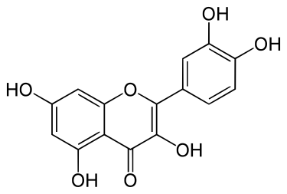
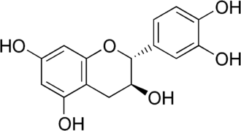
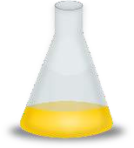
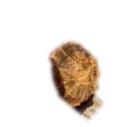
Plausible Mechanism of Reaction
quercetin
catechins

Slide 12
Data Analysis
F value > F table => the concentration of gambier leaf extract (X) has an influence on dissolved calcium levels (Y).

Slide 13
Conclusion
There is an effect of ethanol extract of gambir leaf as antinephrolithiasis agent, the higher the concentration of ethanol extract gambier leaves, the higher the calcium levels of dissolved kidney stones.
The presence of catechin compounds in gambier leaves can react with calcium in kidney stones to form a water-soluble Ca- catechin complex.

Slide 14
THANK YOU

