Slide 1
NANOCELLULOSE EXTRACTION FROM SUGARCANE BAGASSE THROUGH ULTRASONICATION-CHEMICAL COMBINATION METHOD
Oleh :
A’yunil Hisbiyah¹, Lilik Nurfadlilah², Rohmawati Hidayah³
Presented at:
International Conference on Advance Education and Technology
Universitas Muhammadiyah Jakarta
^{12 November 2020}

Slide 2
Nanocelullose
Nanocellulose is a new type of cellulose material characterized by an increase in crystallinity, aspect ratio, surface area, and increased dispersion and biodegradability.
Nanocellulose can be extracted from agricultural waste, one of which is bagasse

Slide 3
Method Extraction
Ultrasonic Wave
Acid Hydrolysis Method
Ultrasonication-Chemical combination method

Slide 4
Stage of Nanocellulose Extraction
Alkali Treatment by NaOH 17,5% w/v
Bleaching by NaClO 0,7% v/v
Acid Hydrolisis by H2SO^{4 45%}
Neutralized with NaOH and aquadest
^{Dried at 60C}

Slide 5
Material Characterization
X-Ray Diffraction (XRD)
to characterize the crystalline structure of cellulose and nanocellulose
Fourier-transformed infrared spectroscopy (FT-IR)
to characterize the chemical composition of extracted cellulose and nanocellulose from sugarcane bagasse
Scanning Electron Microscopy (SEM)
Particle size analysis (PSA)
to charaterize morphology
to determine particle size of nanocellulose

Slide 6
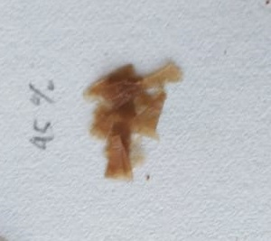
Nanocellulose Extraction

Slide 7
Analysis of Lignoselulose and % moisture content
The Chesson-data test results showed that the cellulose content in C-SB was 51.27%, the lignin content was 22.33%, the hemicellulose content was 8.49%.
The moisture content of C-SB and NC-SB was found to be 1,47% and 3,85%.

Slide 8
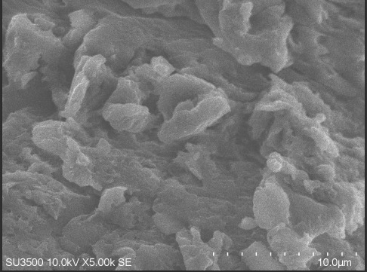
Material Characterization
The average particle size of NC-SB was found to be 132,6 nm. The average length of sample was 205,1 nm while the average width was 42 nm

Slide 9
FT-IR
C=O

Slide 10
XRD
% Cristallinity for SB, C-SB, and NC-SB was found to be 68%; 77,2%; 92,62%.

Slide 11
Conclusion
the nanocellulose with high % crystallinity was succesfully extracted from sugarcane bagasse using a ultrasonication-chemical combination method. % crystallinity of nanocellulose reached up to 92,62%.
The FTIR spectrum showed the broad band at 3300-3500 cm^{‑1} that foud to be the vibration of cellulose OH group. The band around 895 cm ⁻¹ reflect the β-glycosidic linkage between the anhydroglucose units in cellulose.
The average particle size of nanocellulose was found to be 132,6 nm that consisting of the average length of sample was 205,1 nm while the average width was 42 nm.

Slide 12
ACKNOWLEDGMENT
The author would like to thank the Ministry of Research, Technology and Higher Education who has provided research grant 2020 through Penelitian Dosen Pemula with contract number 083/SP2H/LT/DRPM/2020; 128/SP2H/LT-MONO/LL7/2020; 004/STIKESRSAM/SP-Penelitian/III/2020

